Slide 1

Movie Data Analysis
The recipe for a successful Movie
By Sharvari Nagesh

Slide 2
Problem Statement
This is a movie data set from the INSAID Git hub page. It captures the movie information like Genres, year, revenue, rating, metascore and Votes. The effort is to analyse the movies and find the recipe for successful Movies. And answer questions like Who, how and when the successful movies are made? We try to answer below question as part of EDA.

Slide 3
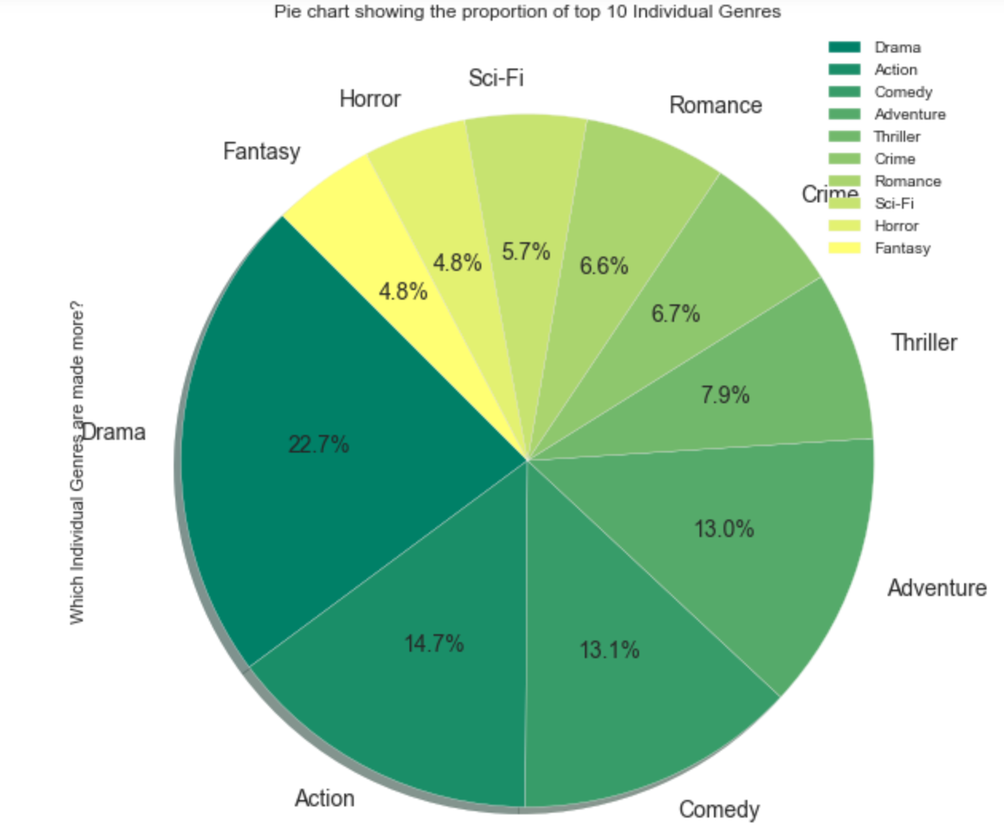
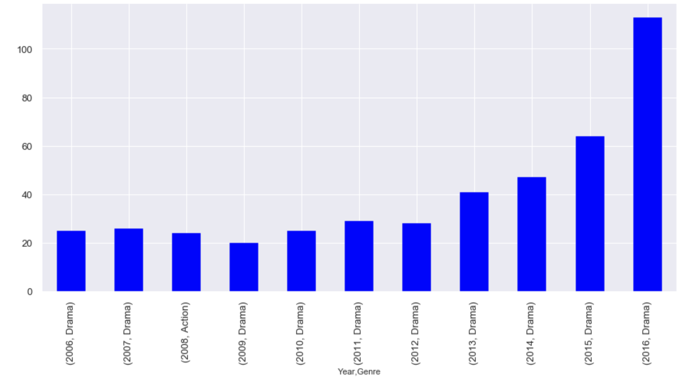
Which genre movies are made more
The Drama movies are the most made movies. Even when we break the data year-wise, it’s the Drama which are the most made movies between 2006 and 2016.

Slide 4
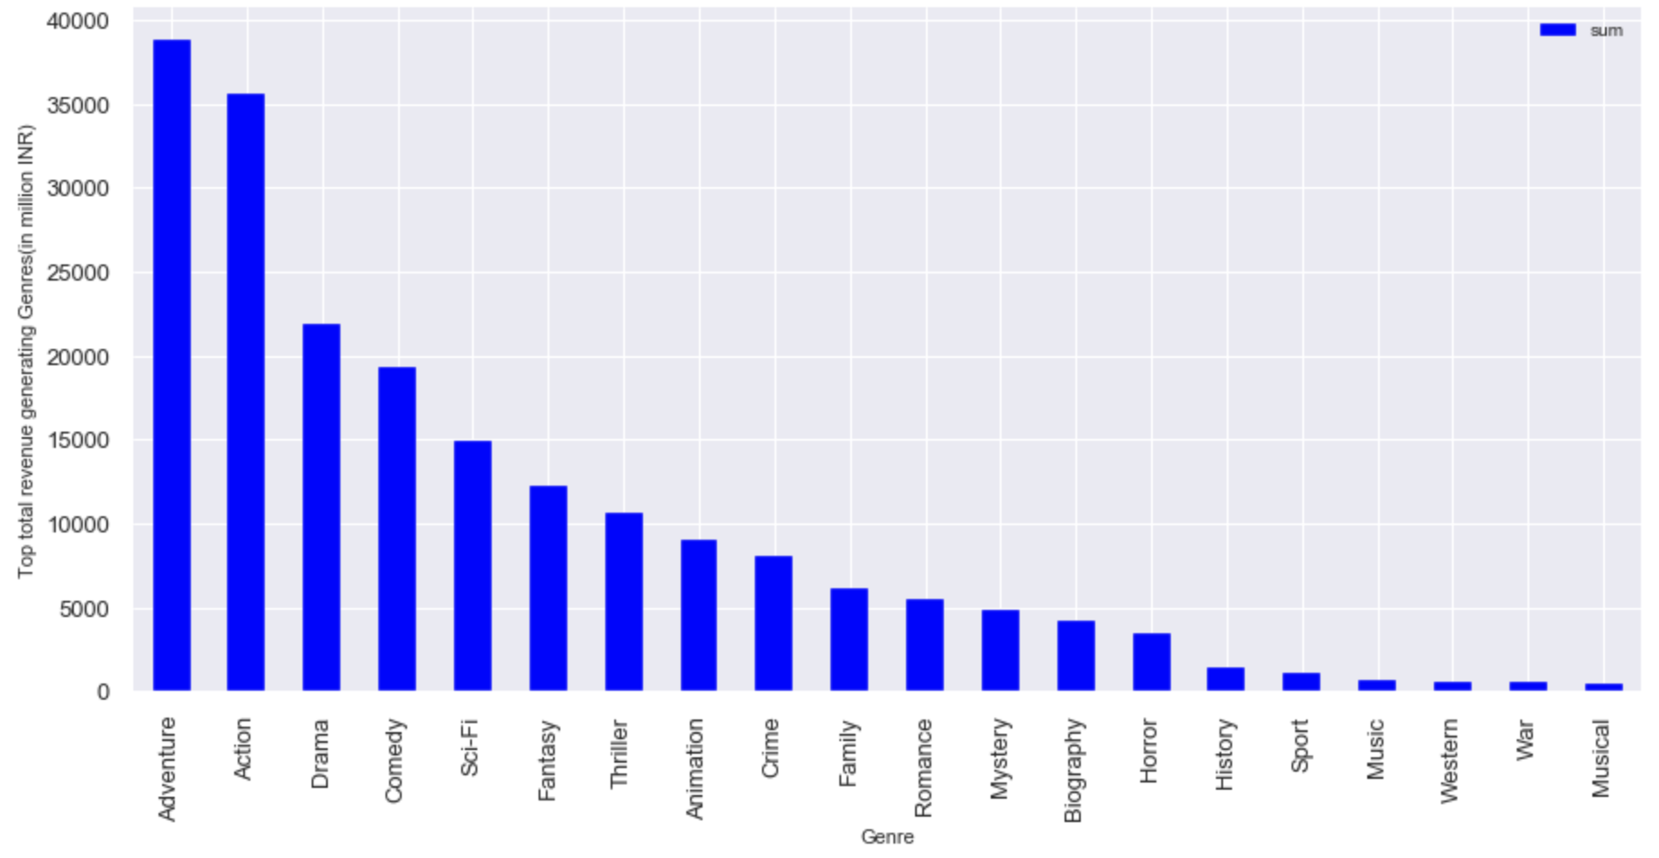
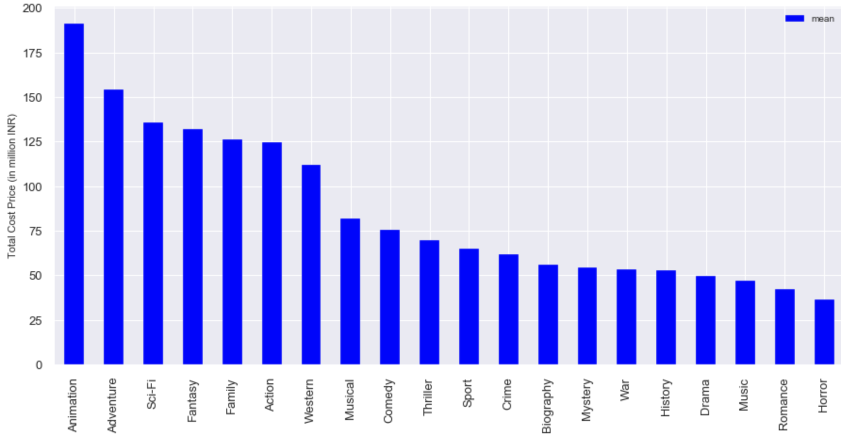
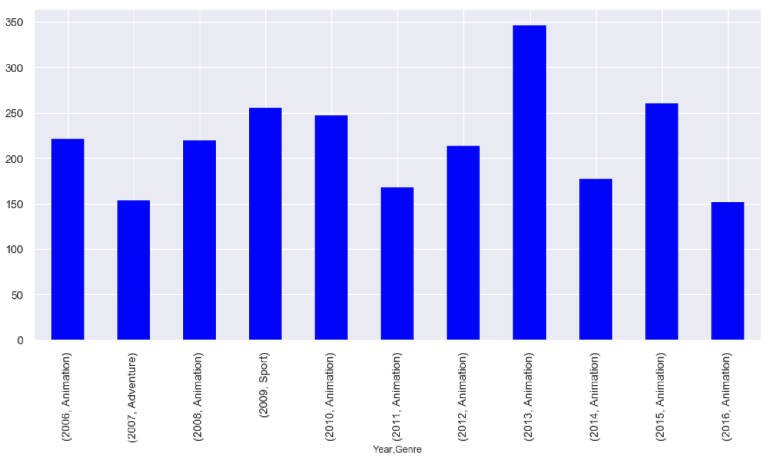
Which Genre movies generate more revenue
Though it’s Adventure and action movies which have generated more total revenue, On an average Animation movies make more money. This is evident when we plot genre wise average revenue and year wise average revenue

Slide 5
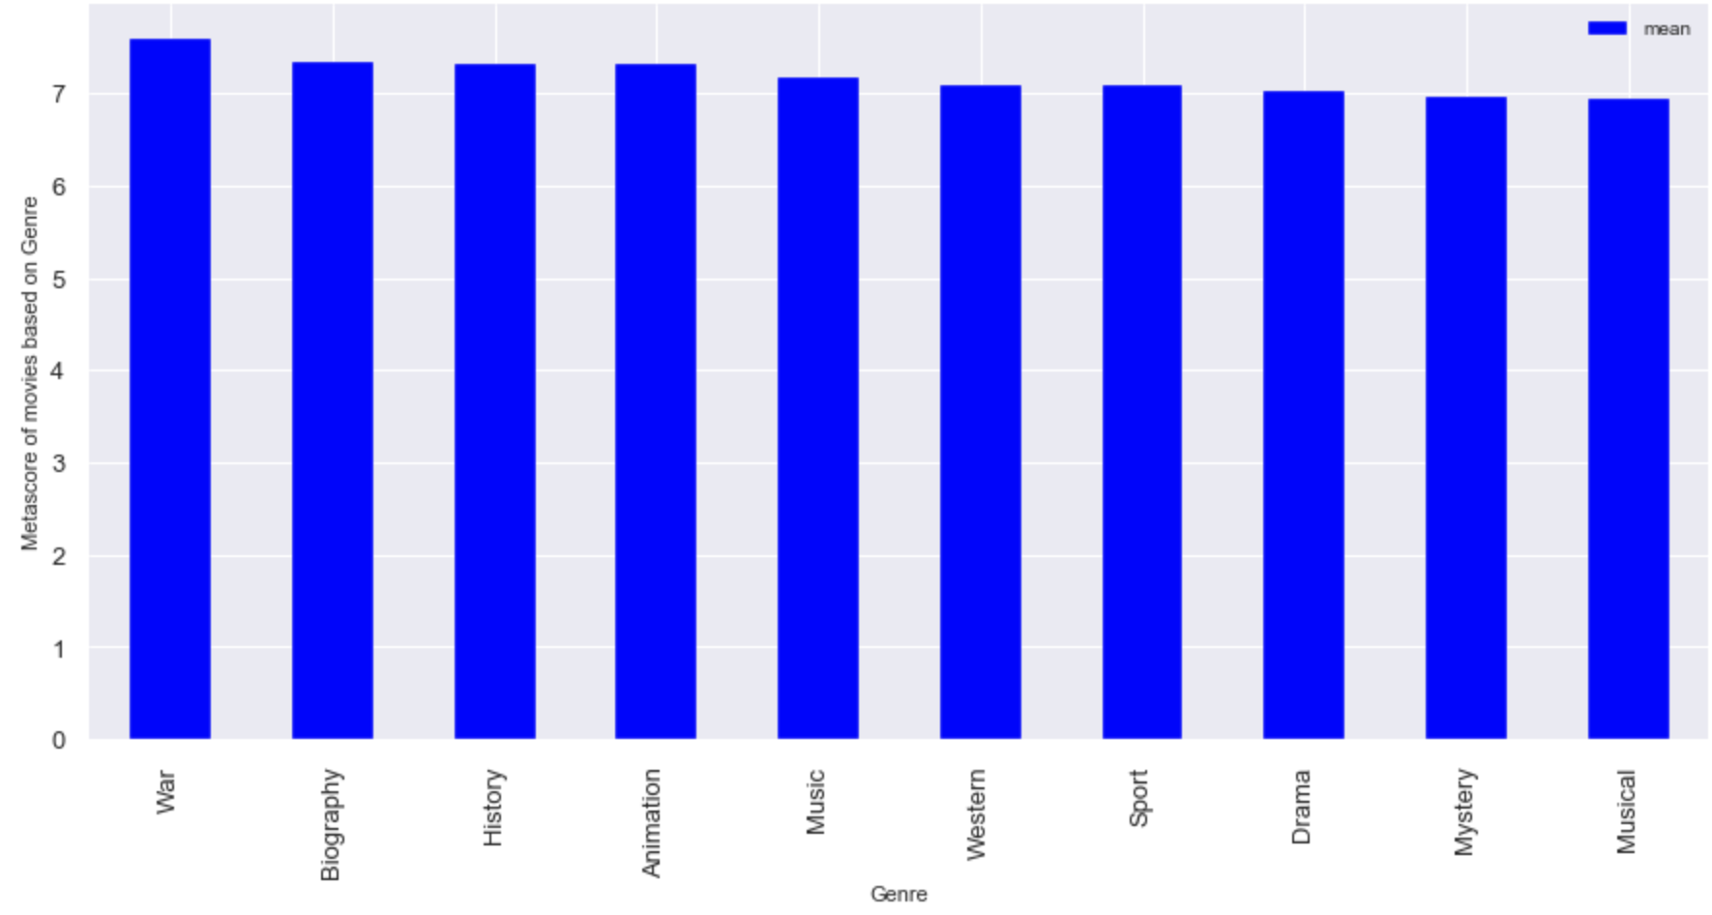
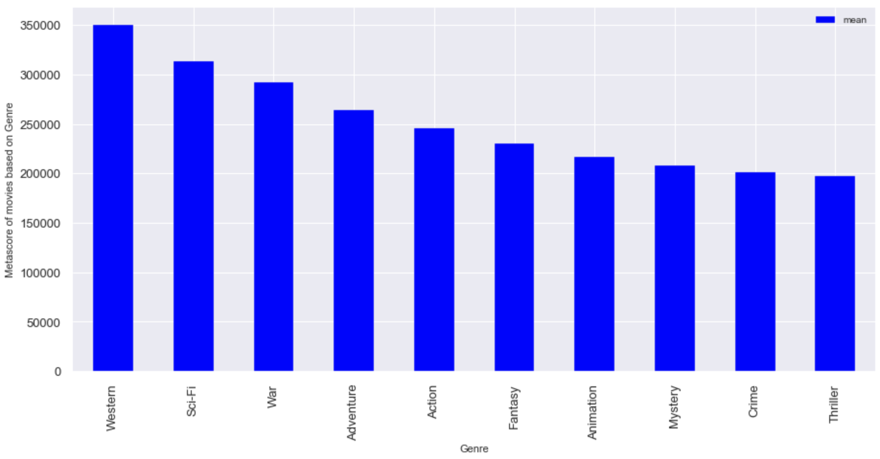
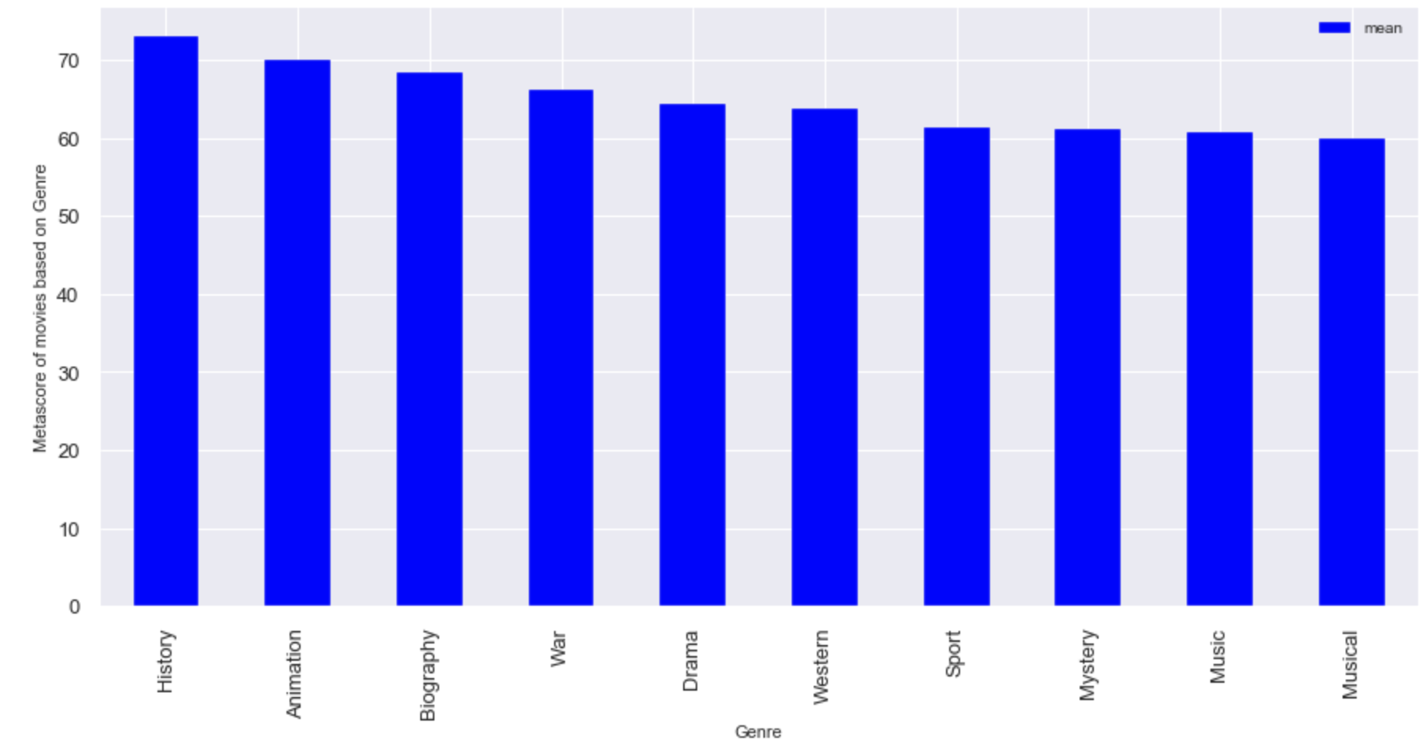
Analysing Votes,Rating and Metascore of each Genre movies
By looking at the bar charts, it is visible that Genre has very less effect on the Rating/Metascore/Vote of the movie. Irrespective of the Genre, if movies are made well, they gate better Rating/Metascore/Votes.
.

Slide 6
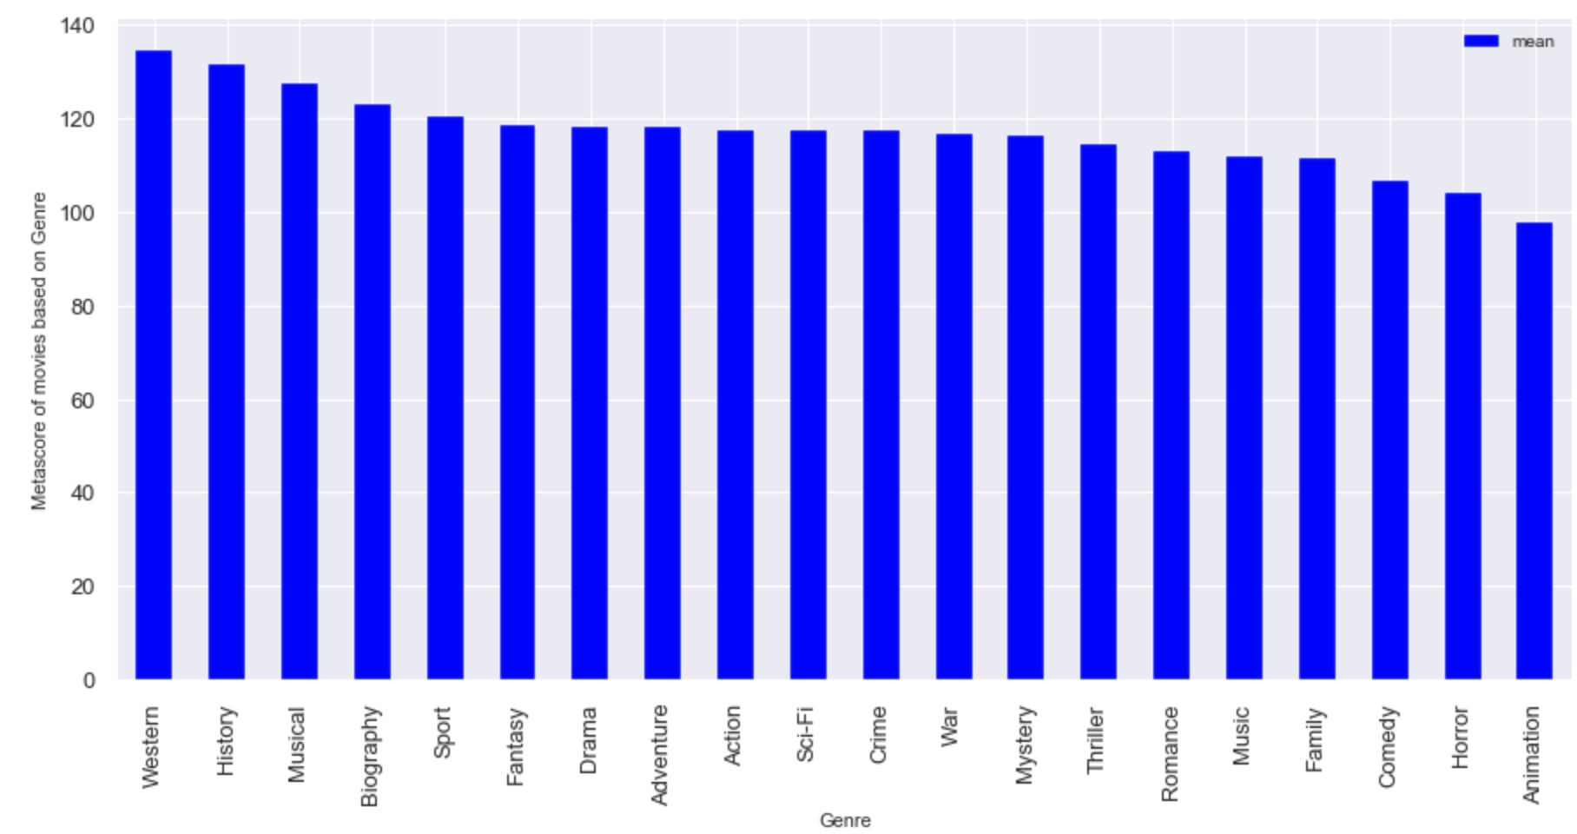
Comparing Runtime and Genre of the movie
It’s evendent that revenue generating, popular movies are not the longest movies. Especially Animation movies which are the most revenue generated movies are the shortest on an average. This is because these movies are made for kids.

Slide 7
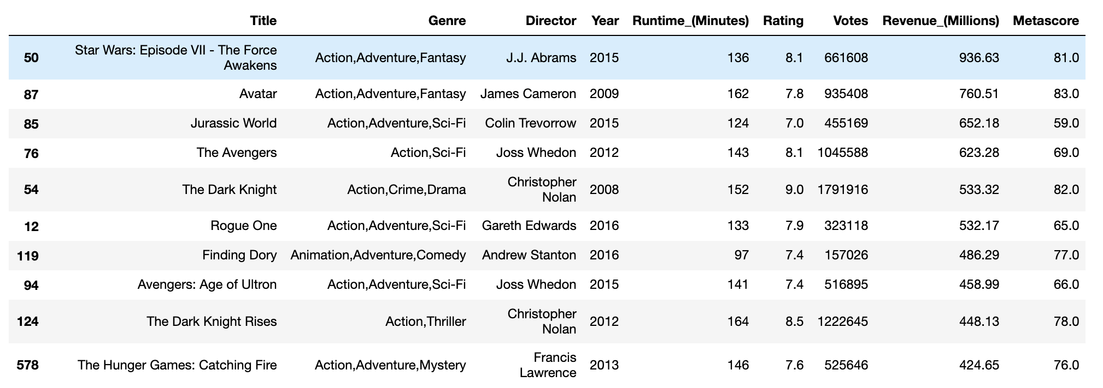
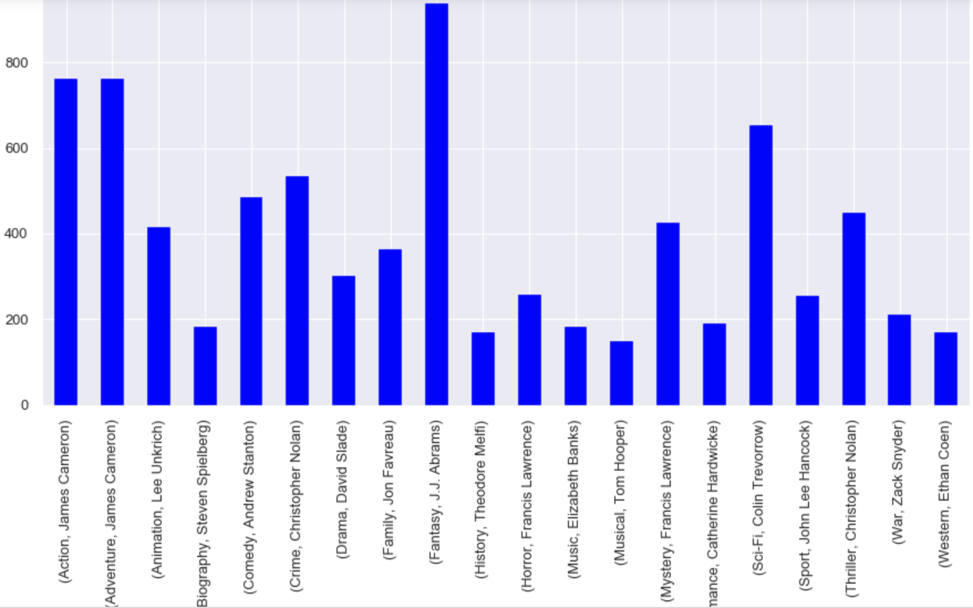
Most successful movies and Directors
Most revenue generating movie is “Star Wars VII- The Force Awakens” where as most successful director is JJ Abrams. No wonder JJ Abrams is the director of the movie, “Star Wars VII- The Force Awakens”

Slide 8
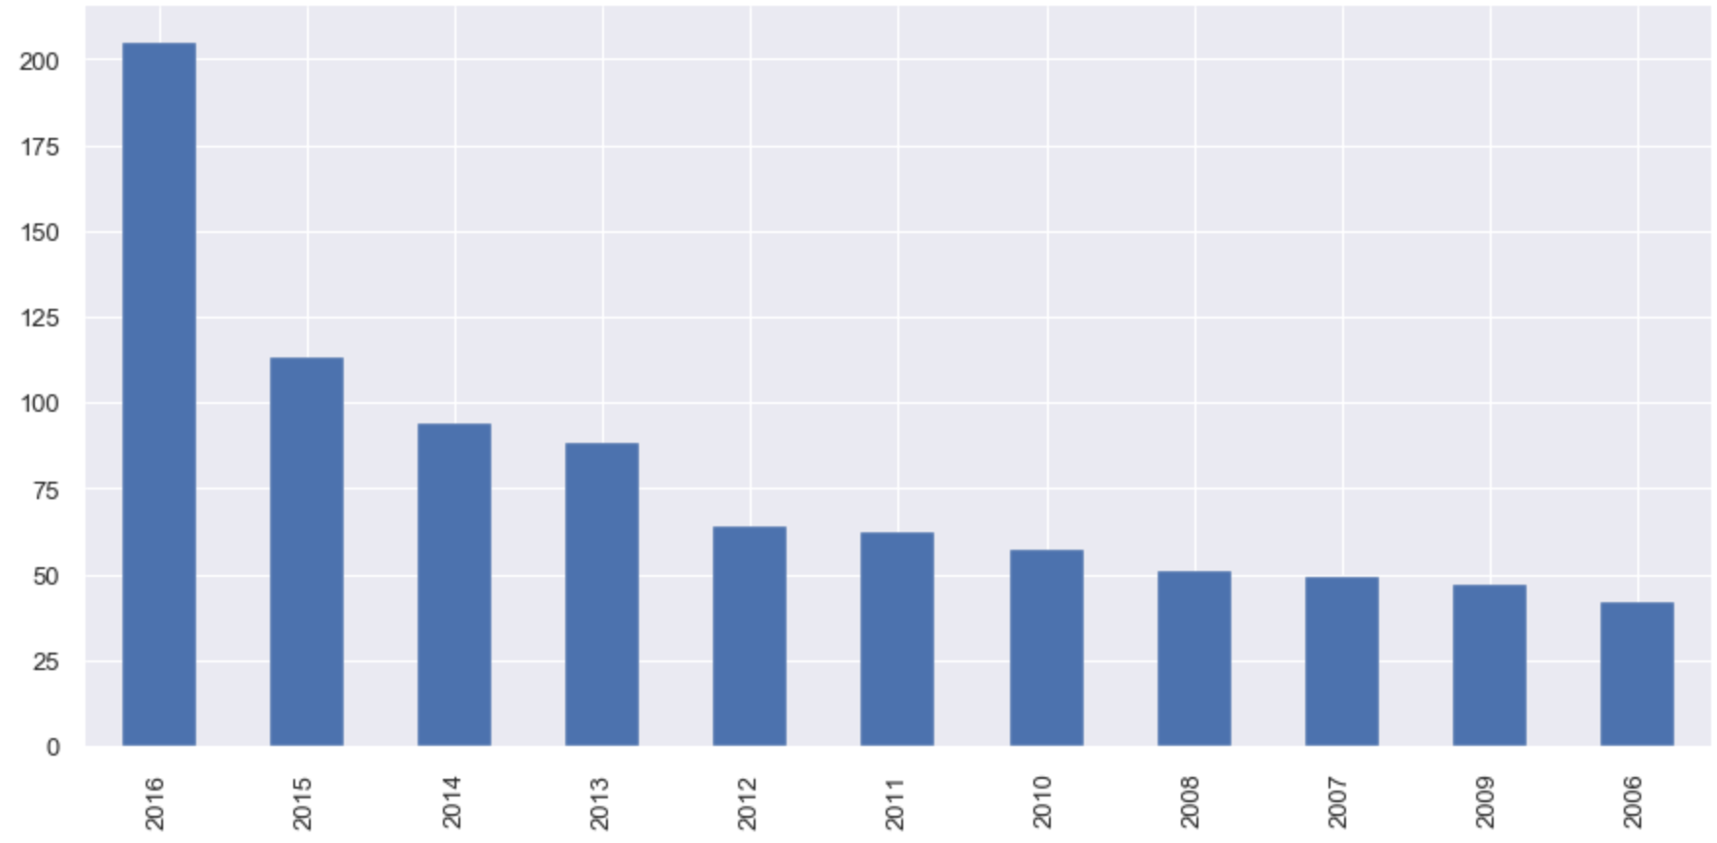
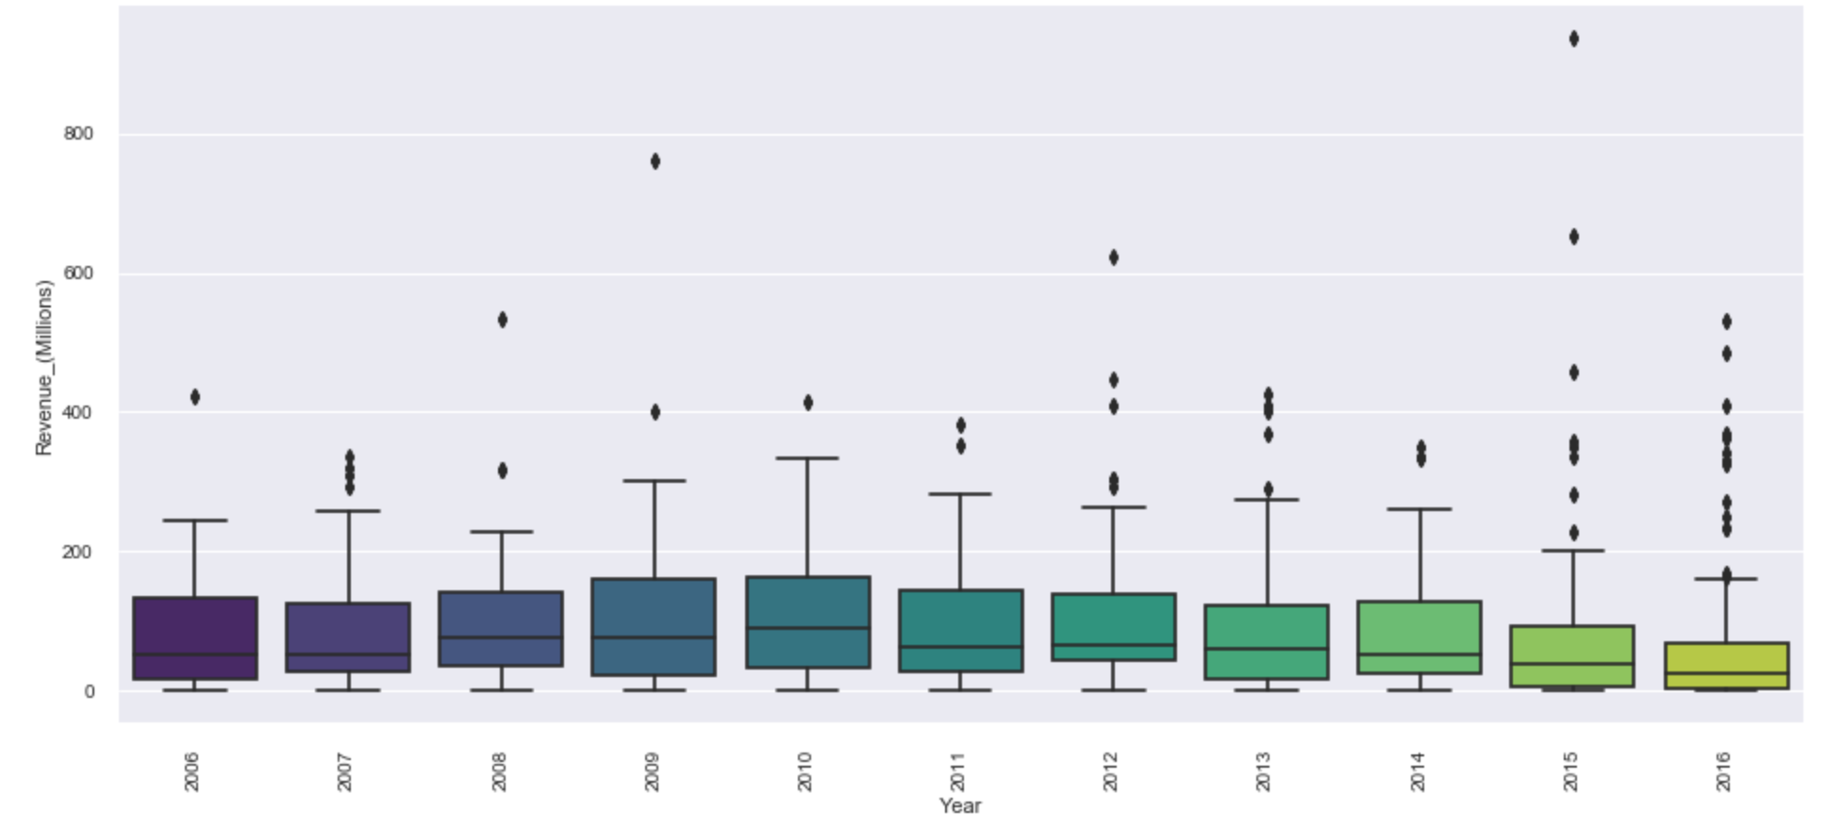
Movies made in each year and their revenue
There are more number of movies made in year 2015 & 2016. There is a gradual increase in the number of movies made each year. But when we see their revenue, on an average 2015,2016 movies are not good. There are outliers in both the years but more number of movies doesn’t make more revenue for each of the movies.

Slide 9
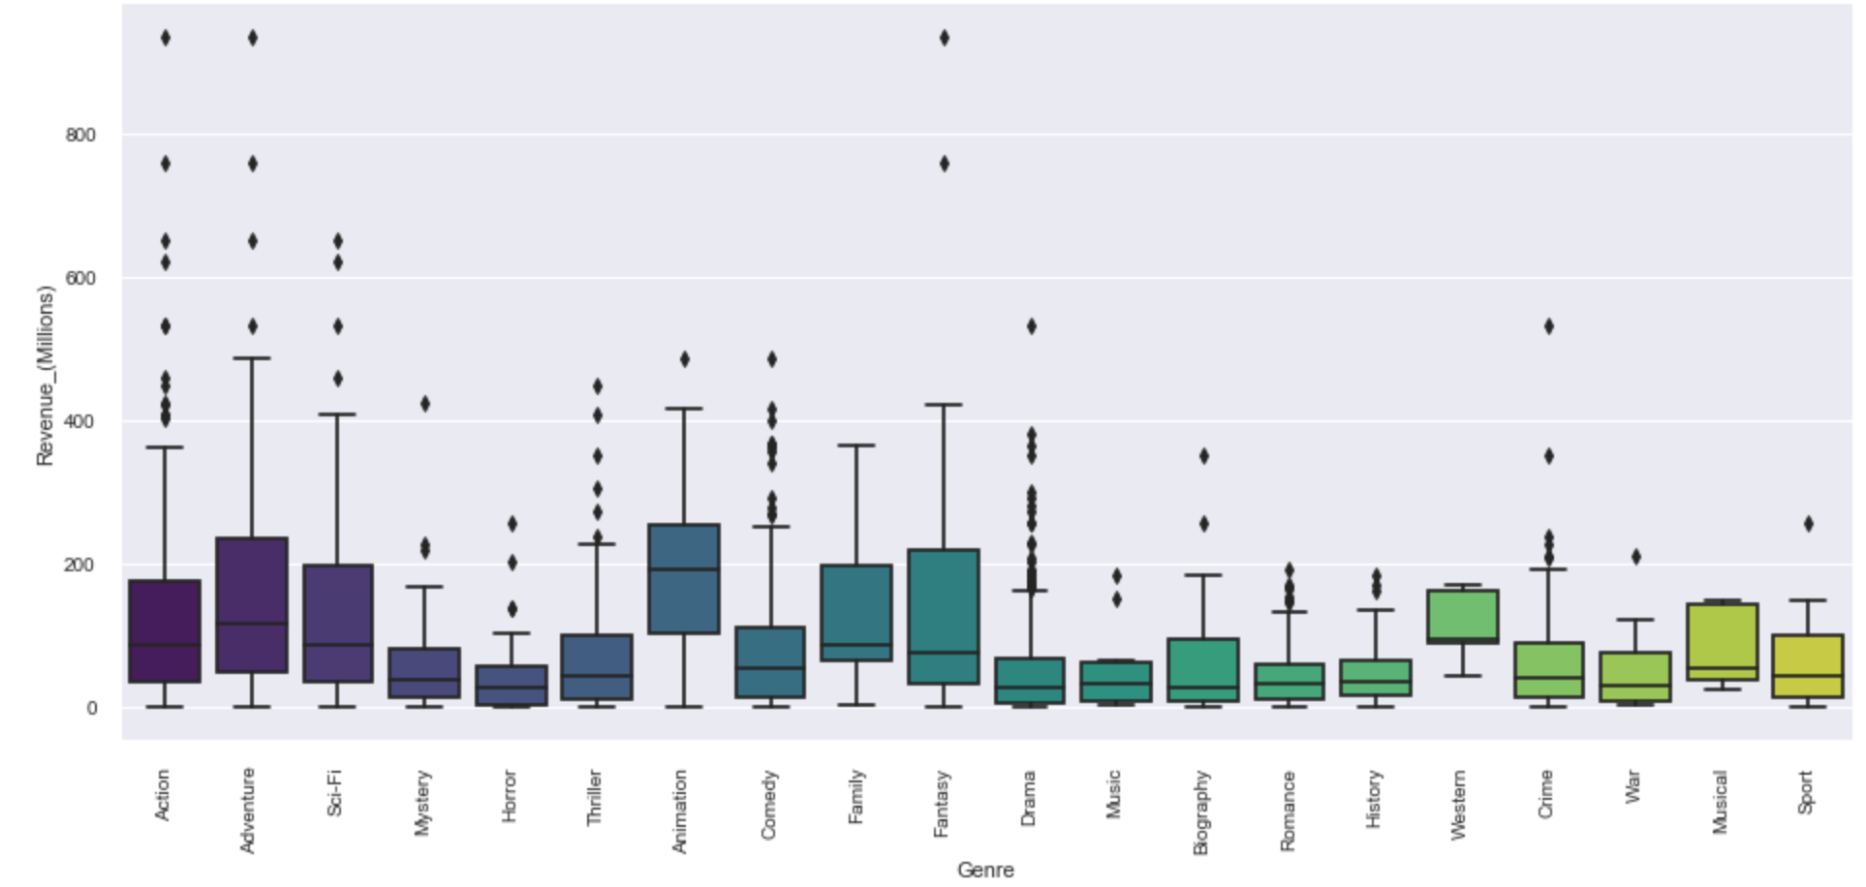
Relationship between Genre and Revenue
From the above chart we can see that Animation movies make more revenue in general. There are outliers in most of the Genres but outliers in Action, Adventure and Fantacy have generated way more money than any other Genre movies.
So most of the animation movies generate good revenue but if you want to make a super hit movie, Action, Adventure and Fantacy are the Genres to choose from.

Slide 10
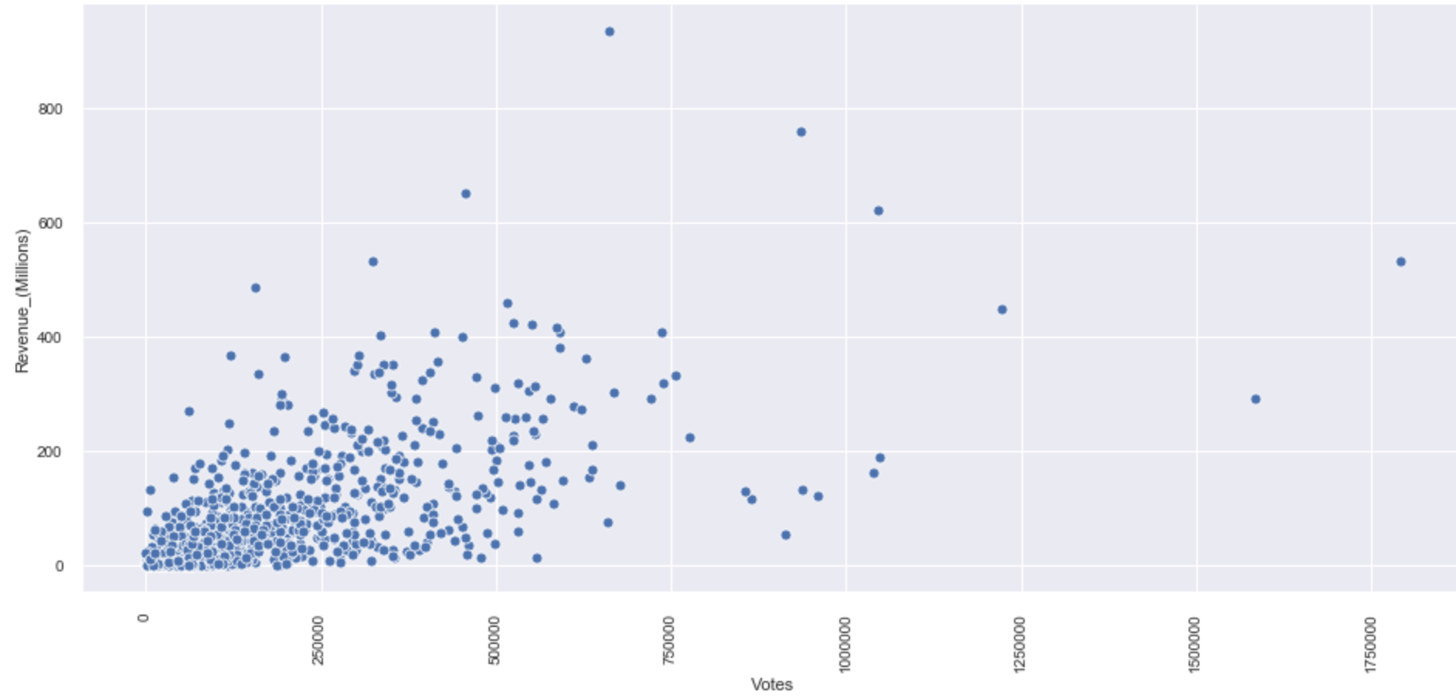
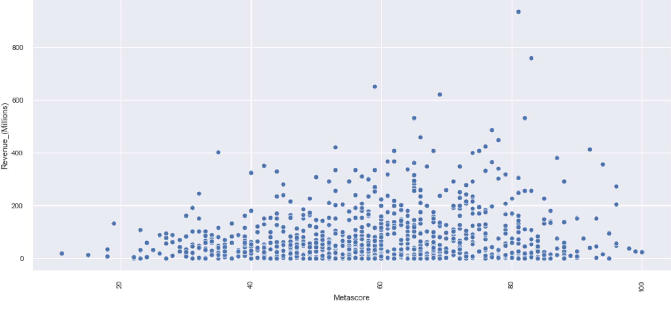
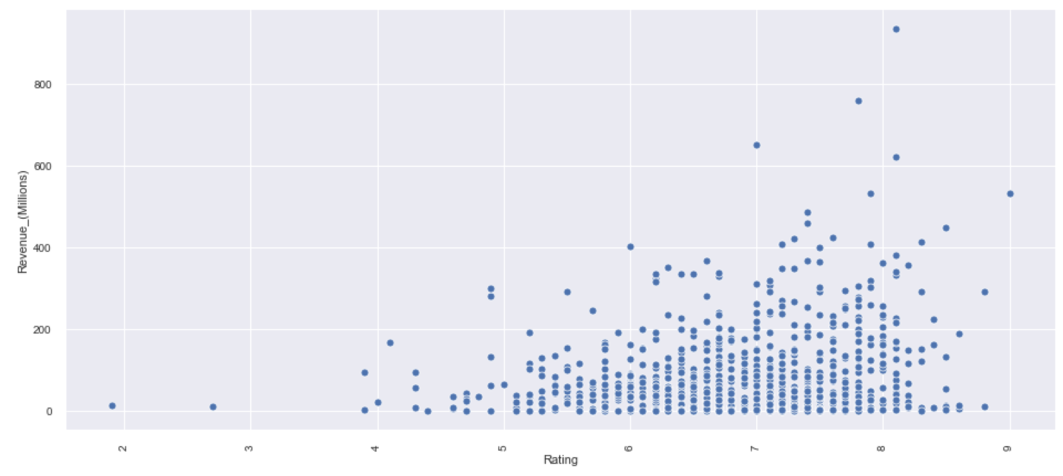
Are Rating/Voting/Metascore related to Revenue?
It is clear that most of the revenue generating movies have better rating but vice versa is not true. Just because the rating is high, does not mean that the movie will generate more revenue.
There is less corelation between revenue and Metascore when compared ot revenue and Rating. even average critic rated movies also have done relatively well in box office. All movies with high critic rating are not doing well in generating revenue.
Most of the movies which have generated more revenue have garnered good votes. But looks like not many people bother to vote.

